Slide 1
CBD Revitalisation
16 May 2023

Slide 2
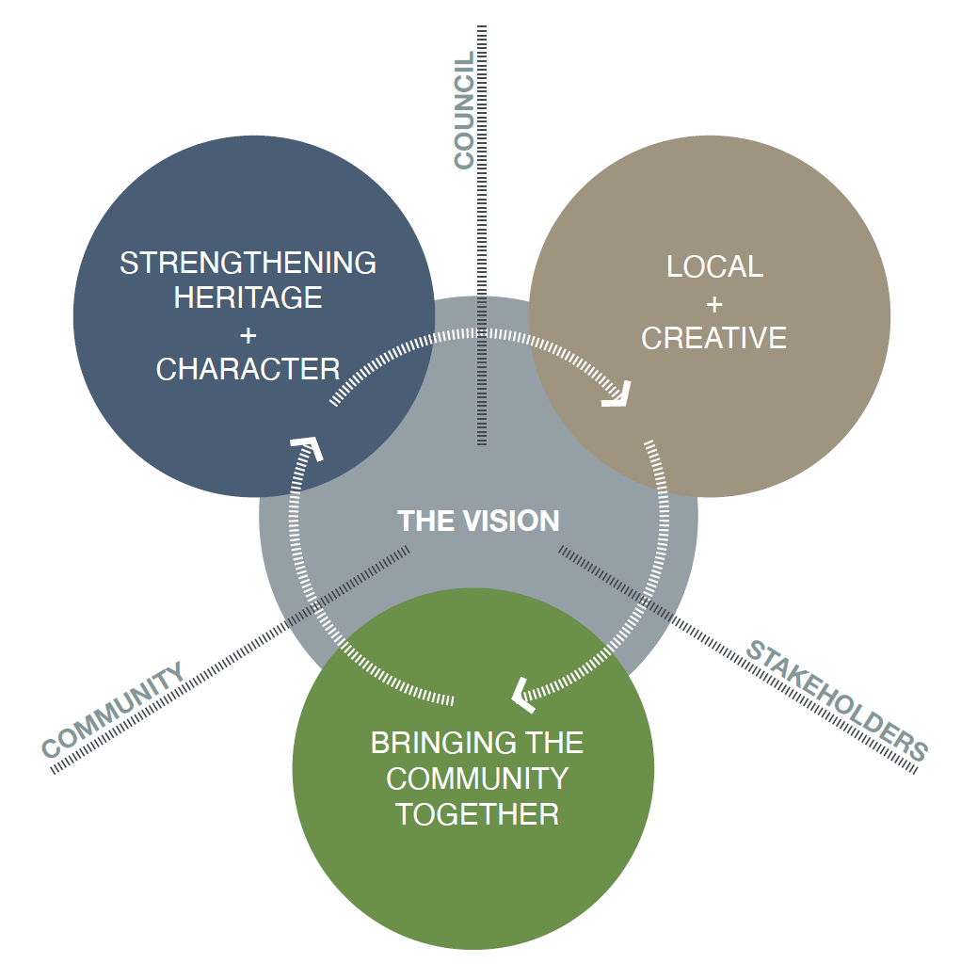
Vision and Key Themes
The vision for the Hamilton Town Centre is broken down into 3 key themes:
Strengthening Heritage and Character
Local and Creative
Bringing the Community Together

Slide 3
STRENGTHENING HERITAGE
+ CHARACTER
Hamilton has a strong history and character. The community wants to see its history, stories and values told and strengthened throughout the public realm. Any changes and improvements into the future need to protect the existing heritage, but also be seen as an opportunity to reinforce the local character and community values that make the town unique and special.

Slide 4
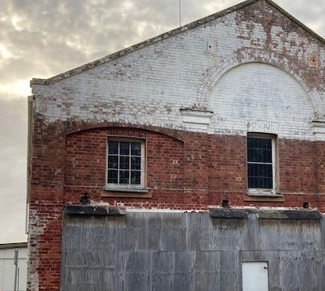
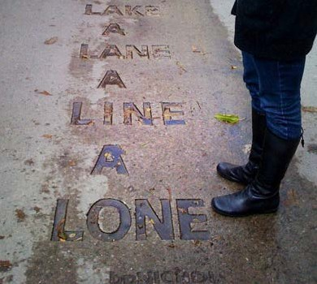
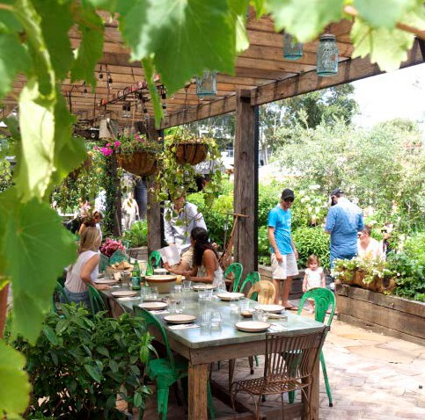
STRENGTHENING HERITAGE
+ CHARACTER
GUIDING PRINCIPLES
SOMETHING OLD, SOMETHING NEW
TELLING OUR STORY
CHARACTER AND A SENSE OF PLACE
Giving new life to old buildings and forgotten spaces – Hamilton has many unique heritage buildings + features that are ‘hidden in plain
sight’ and need to be better celebrated. ‘New’ is encouraged, but needs to occur in a way that preserves and celebrates the ‘old’.
Telling story of the local area and its history
through everything we do - add events, activities and experiences that celebrate and increase
awareness of the town’s heritage in an interesting, creative and authentic manner.
Finding what the community values most and embedding this into the character of any future
improvements. ‘A green community’, ‘slow town’, boutique, eclectic and hand-made - what is our
identity, what makes us special and how can these be reinforced through future improvements?

Slide 5
LOCAL
+ CREATIVE
Hamilton is a place with a strong connection to the local landscape and
its history based around farming, growing and making. Through its isolation and
farming heritage it is a town that has developed a sense of self reliance, local pride and a belief that when the community comes together ‘things get done’. There is also a strong community of local creatives, makers and doers, and a desire to build new local skills and industries that will provide employment and help attract and retain people in the area.

Slide 6
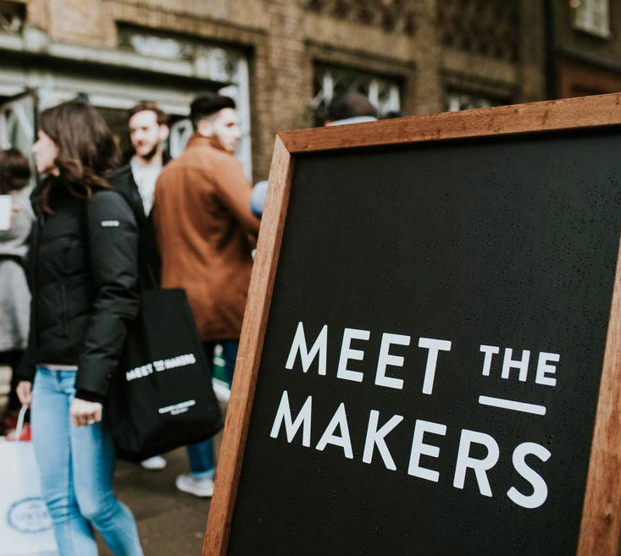
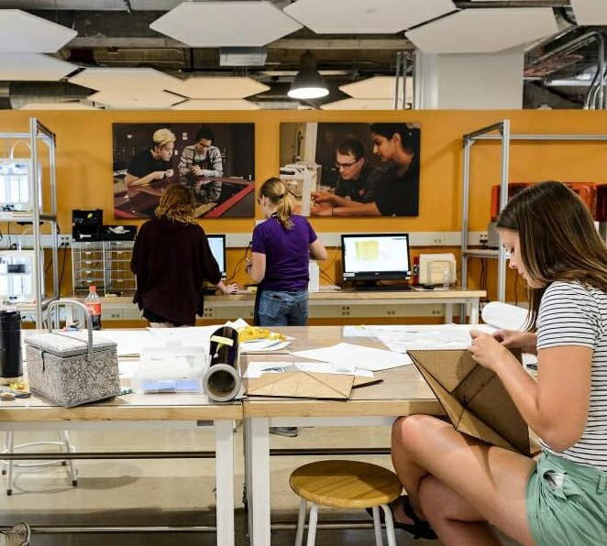
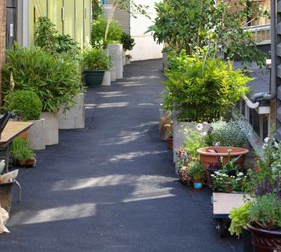
GUIDING PRINCIPLES
LOCAL
+ CREATIVE
‘MADE BY US’
‘MAKING’ SPACE FOR LOCALS
A ‘CREATIVE’ APPROACH
Look for new opportunities, events and initiatives to bring together local makers, growers, creatives
+ traders and get them directly involved in shaping the built environment and future of the town
Providing a variety of spaces that provide new opportunities for local makers and creatives to
meet, share ideas, develop new skills, and ‘grow’ their businesses - ranging from small ‘hole-in-
the-wall’ micro spaces through to larger ‘maker’ workshop style facilities
Using pop-up + semi-permanent approaches to demonstrate and test changes within the street
+ other public spaces. Helps to provide a more creative character and allow locals to have more direct and ongoing input into change

Slide 7
BRINGING THE COMMUNITY TOGETHER
Strengthening the role of the town centre as the place where the community comes together - the place where locals go to shop, meet and chat and just hang out. We need to provide new activities, events and spaces that draw people in and make them want to stay - making the town centre the heart of the community for both special events and everyday life.

Slide 8
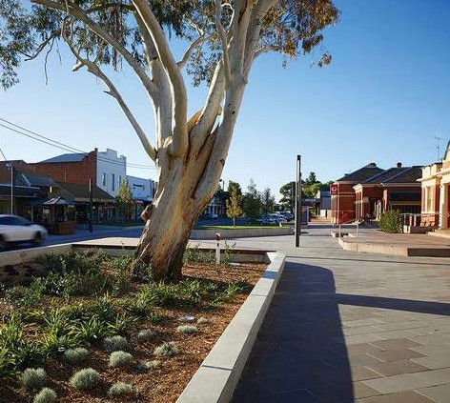
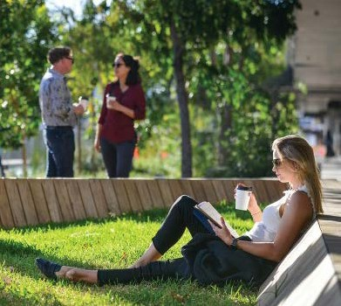
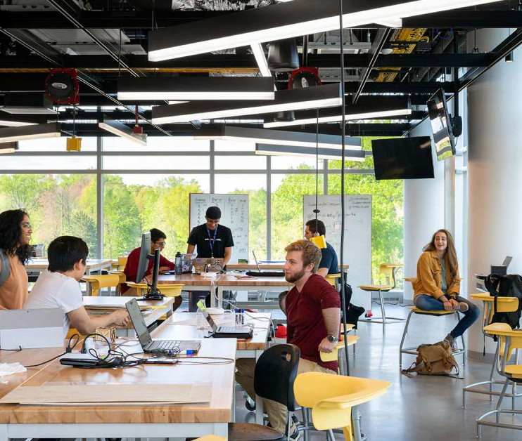
BRINGING THE COMMUNITY TOGETHER
GUIDING PRINCIPLES
THE HEART OF THE COMMUNITY
MORE WELCOMING
MORE TO DO
Providing more and better spaces for the
community to meet, hang-out and host events
- ranging from smaller laneway and streetscape spaces through to larger ‘town square’
opportunities
Creating a setting that is more human, relaxed
and welcoming and a more comfortable place for people to people stay and interact - and it can
sometimes just be the simple things (greenery,
comfortable seats, music and natural materials). We are creating the ‘living room’ for the community and a place for people first....rather than cars.
The design of spaces is only part of the experience
- we need to work hard to activate and connect the spaces, encourage multiple uses and provide new activities that will attract visitors and bring local
people into the town as part of their everyday life.

Slide 9
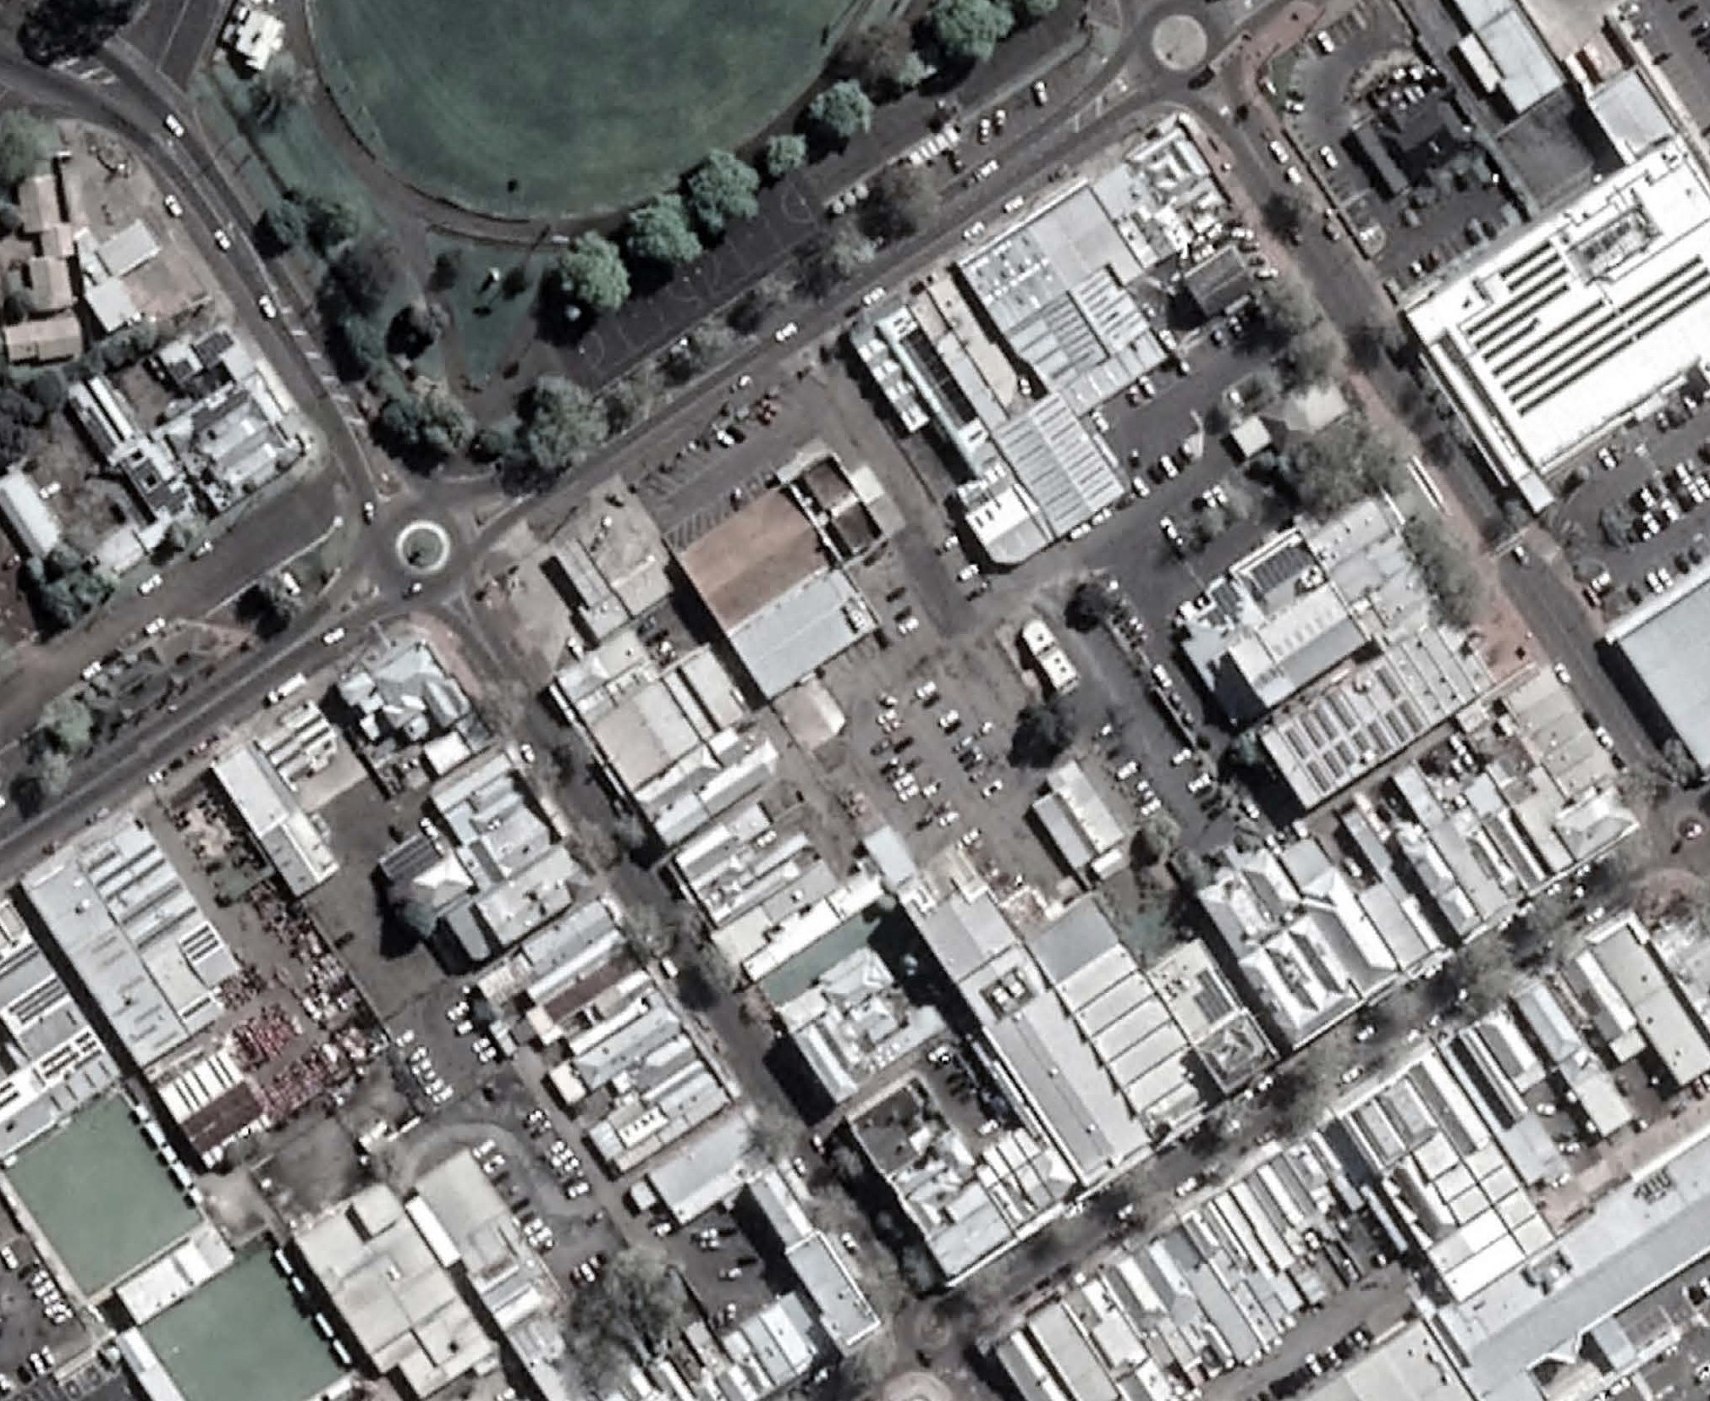
ARTS & CREATIVE PRECINCT
Food / Dining Node
The Arts and Creative Precinct would provide a catalyst and framework for the revitalisation of key streets, laneways, arcades and other public spaces within the Hamilton town centre - helping to add life and vibrancy to the town centre, stimulate new creative and business opportunities, and provide new spaces and places for the community.
LONSDALE STREET
Digital Hub / Creative
/ Makers / Community Spaces
BROWN STREET
Gallery / Arts Node
THOMPSON STREET
The Hub
GRAY STREET

Slide 10
ARTS & CREATIVE PRECINCT
Council Property Acquisitions – Future location of Govt Hub
Location New Town Square
Location of New Hamilton Gallery
LONSDALE STREET
BROWN STREET
THOMPSON STREET
GRAY STREET

Slide 11
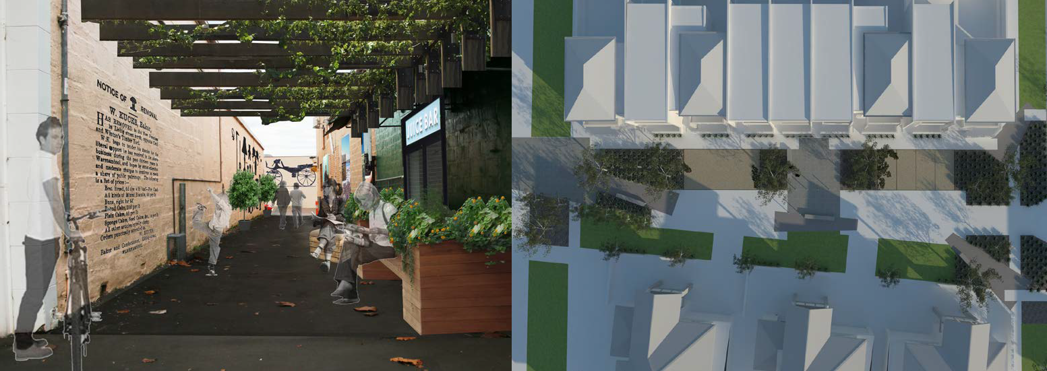
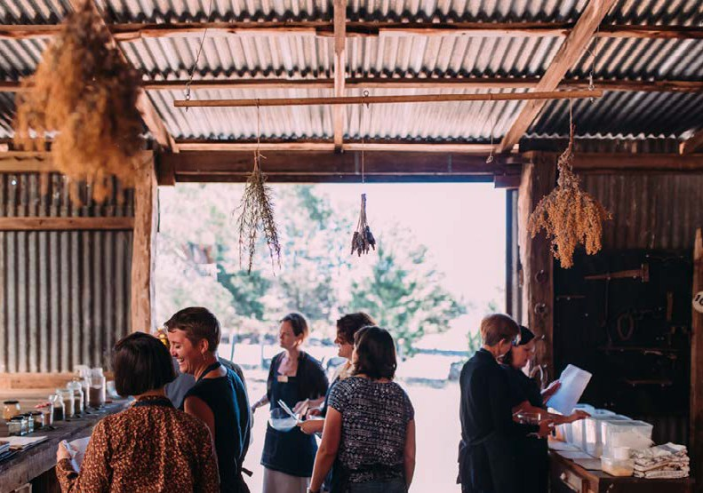
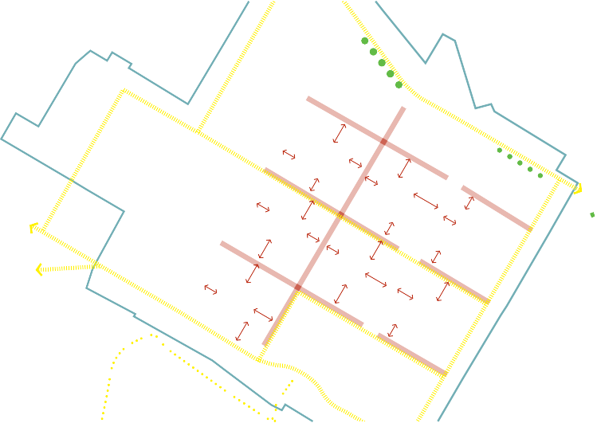
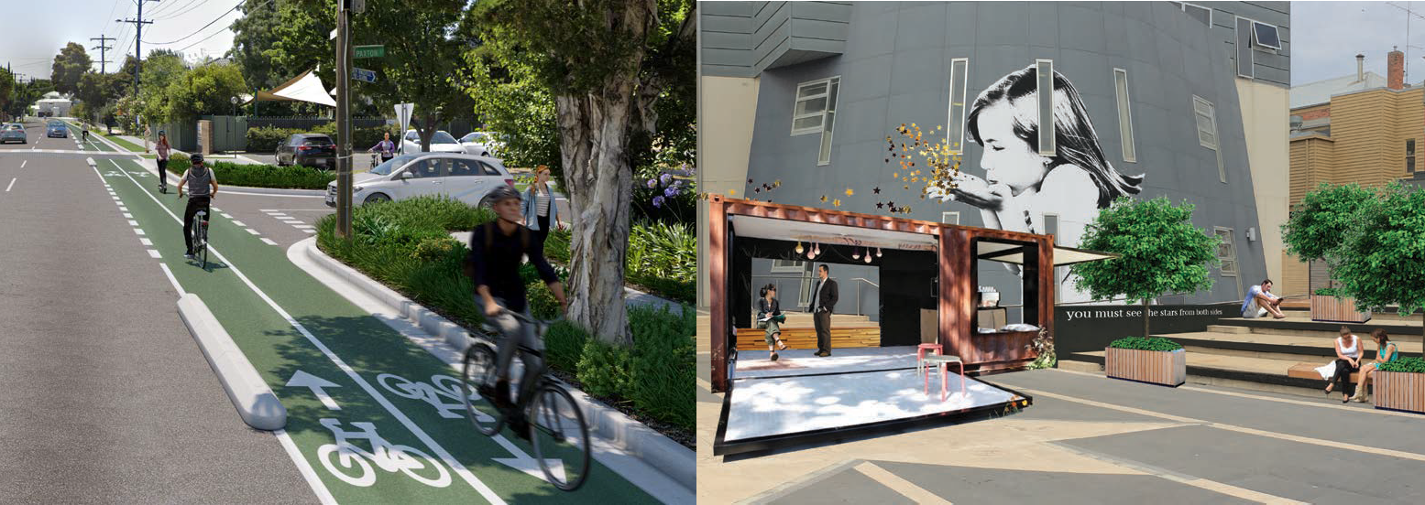
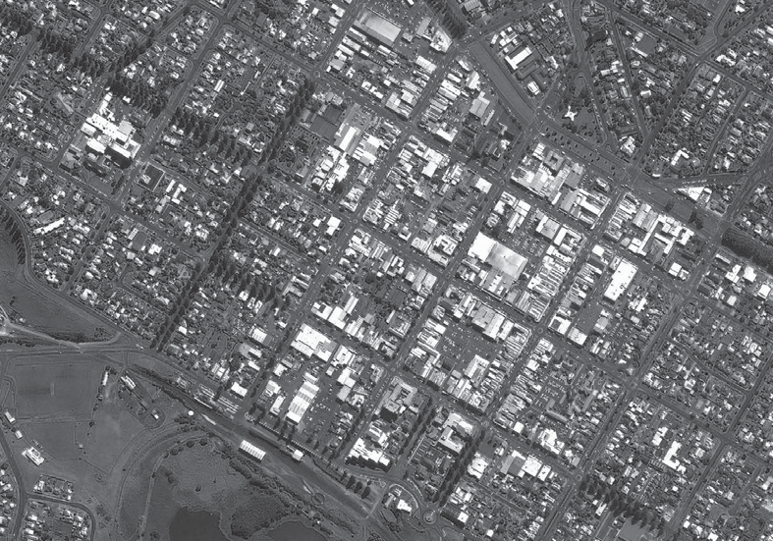
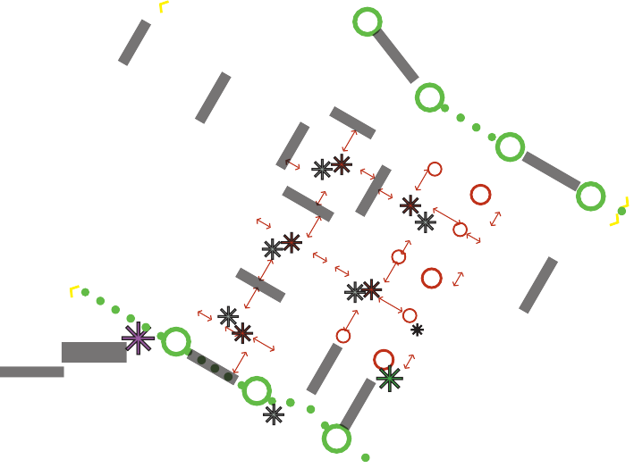
“We shape our buildings........
thereafter they shape us.”
Winston Churchill
Ryot Street
Raglan Parade
South West Hospital
Henna Street
Lava Street
Fairy Street
Raglan Parade
Koroit Street
Kepler Street
Timor Street
Banyan Street
Warrnambool Railway Station
Harris Reserve
Merri Street
Gilles Street
Liebig Street

Slide 12
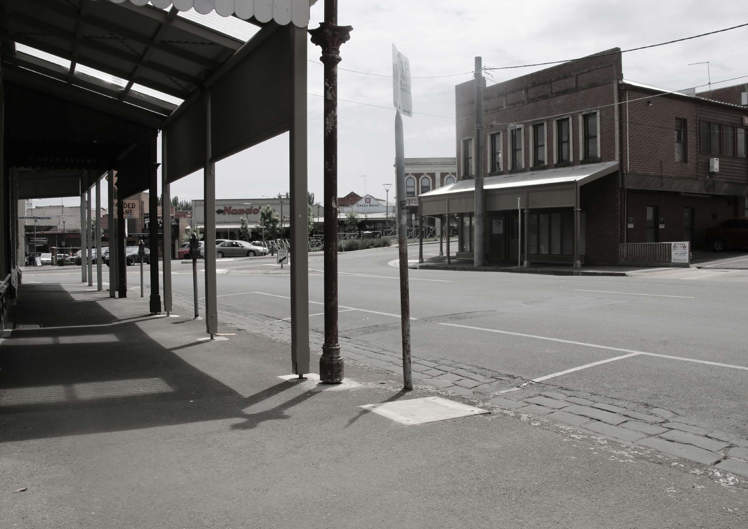
Main Road, Ballarat (VIC)

Slide 13
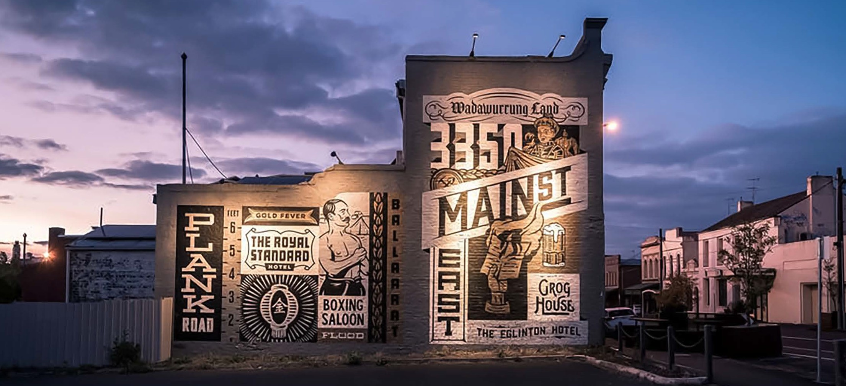
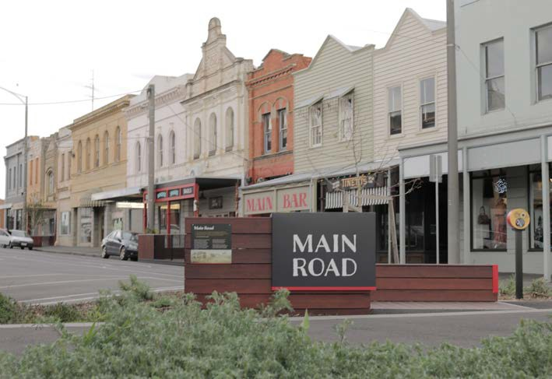
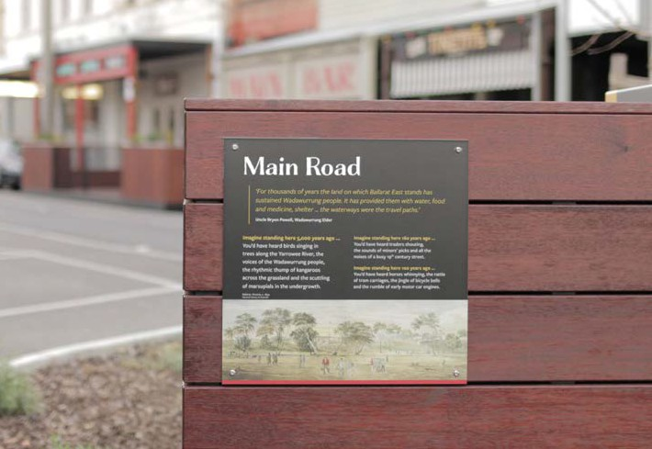
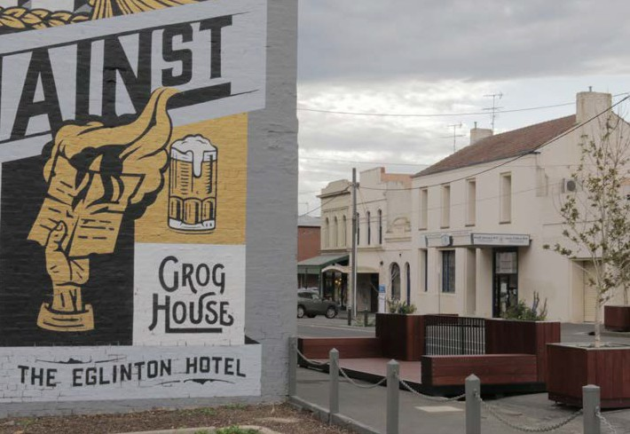
Main Road, Ballarat (VIC)
STRENGTHENING HERITAGE
+ CHARACTER

Slide 14
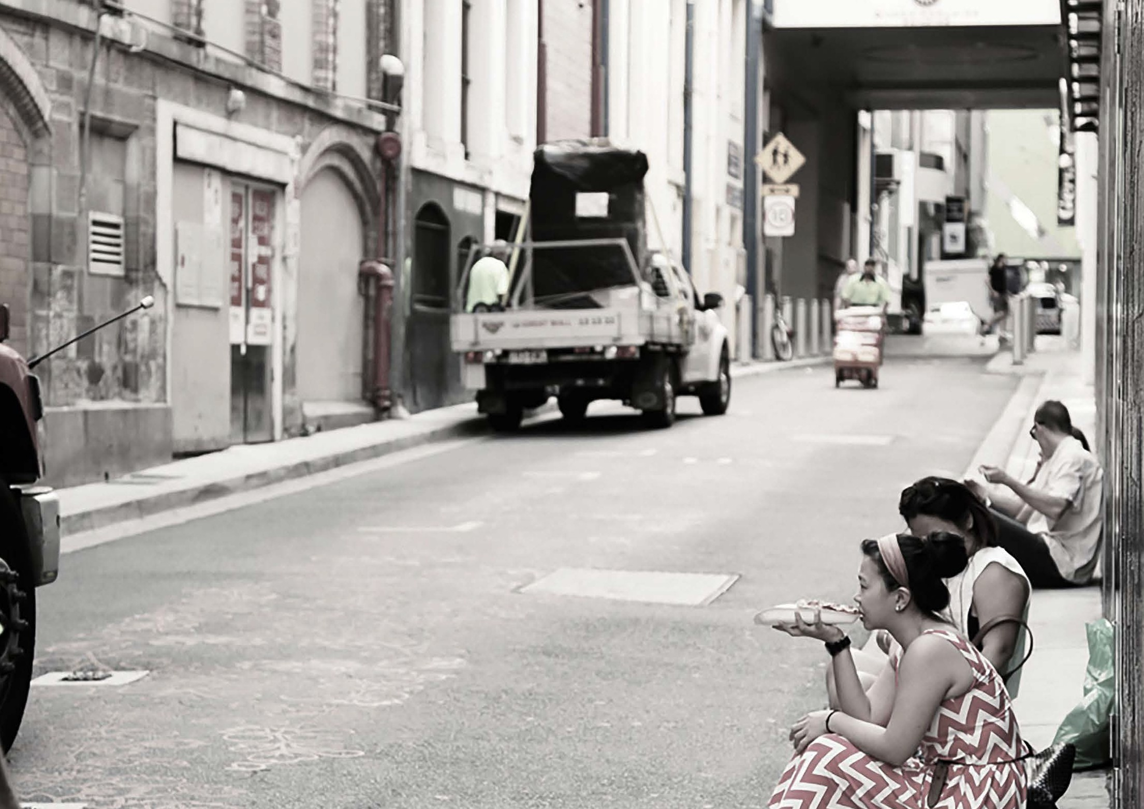
Burnett Lane, Brisbane (QLD)

Slide 15
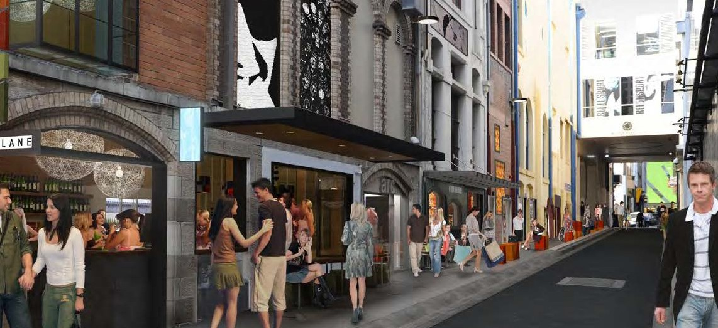
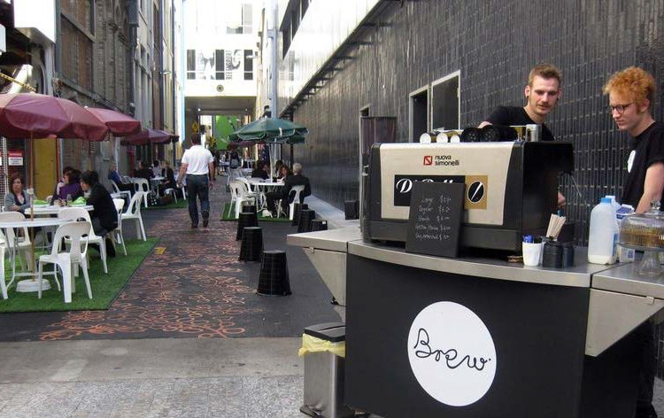
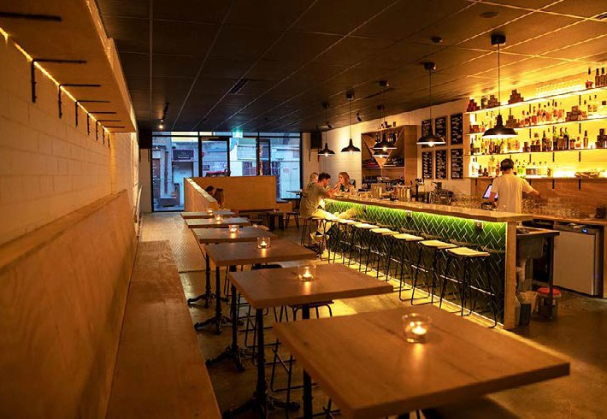
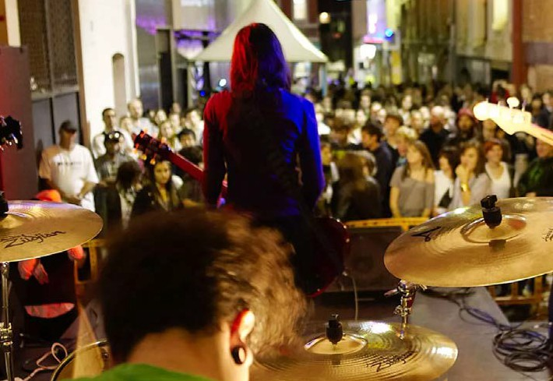
Burnett Lane, Brisbane (QLD)
LOCAL
+ CREATIVE

Slide 16
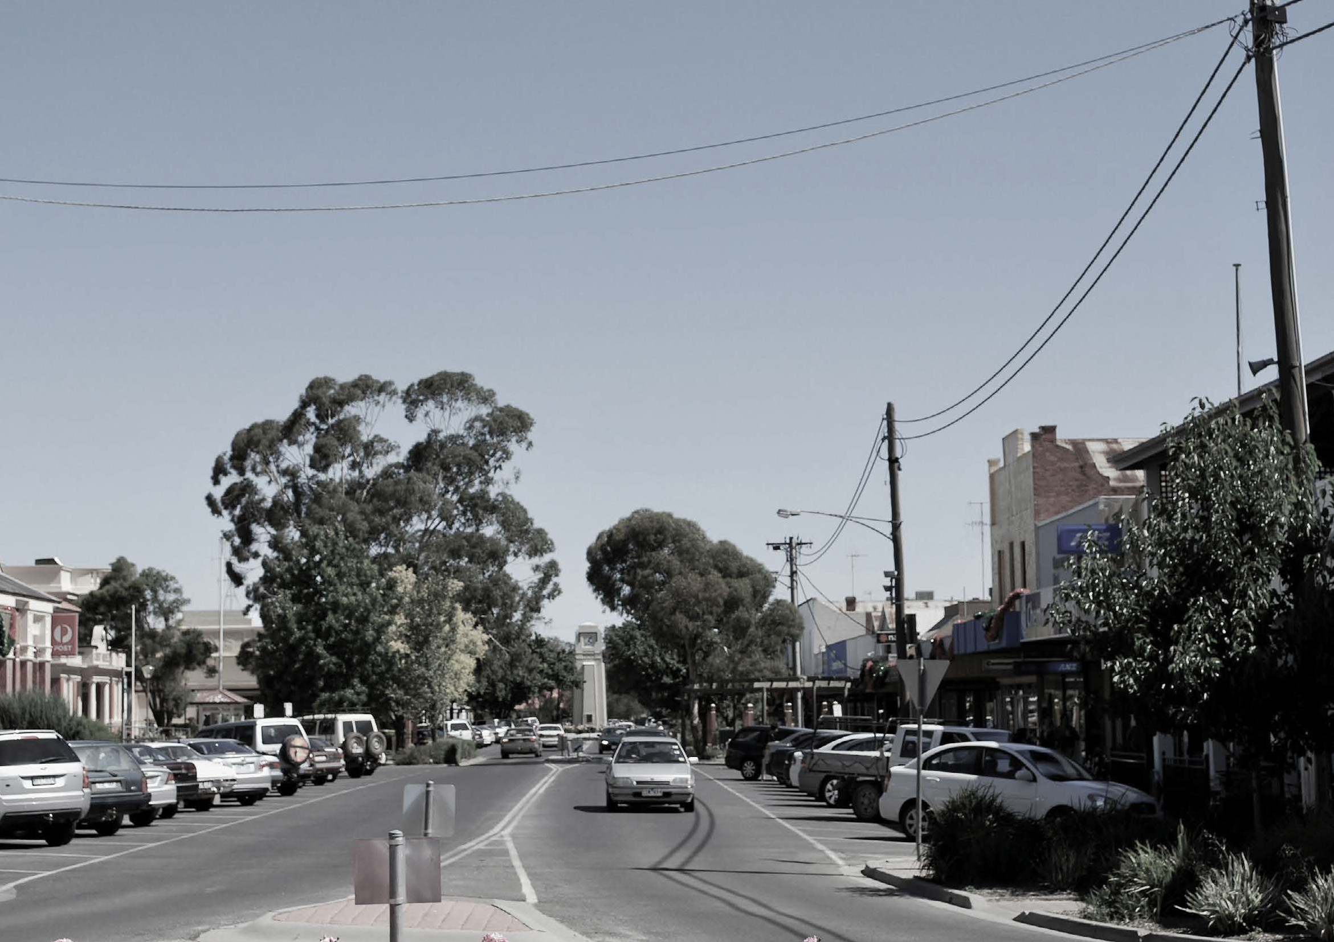
Victoria Street, Kerang (VIC)

Slide 17
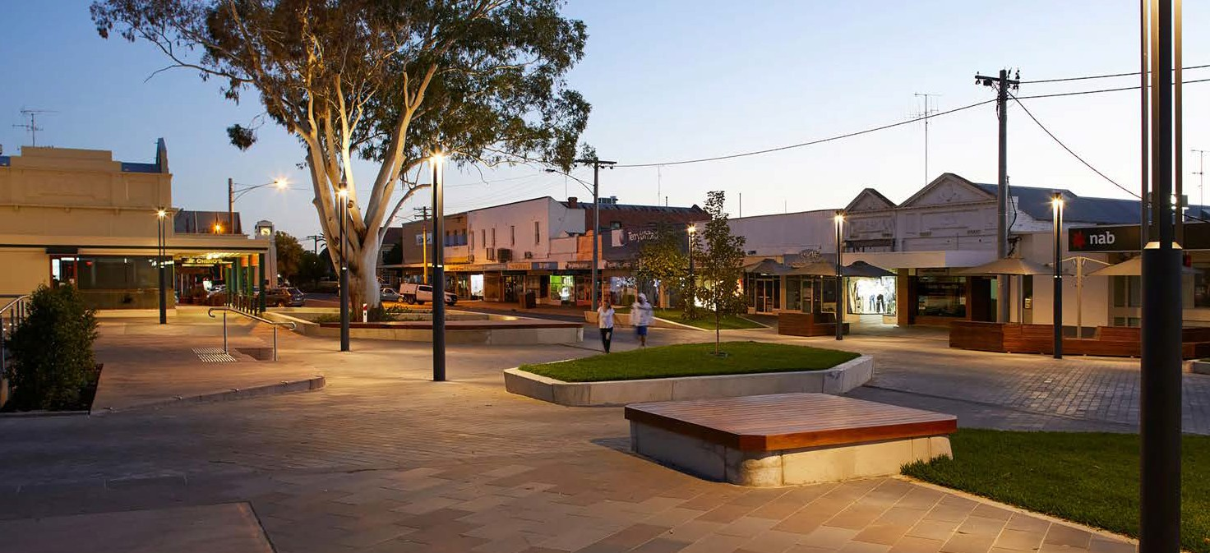
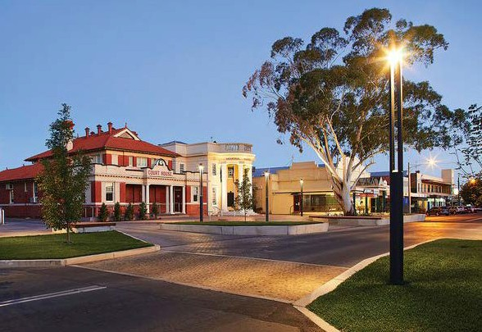
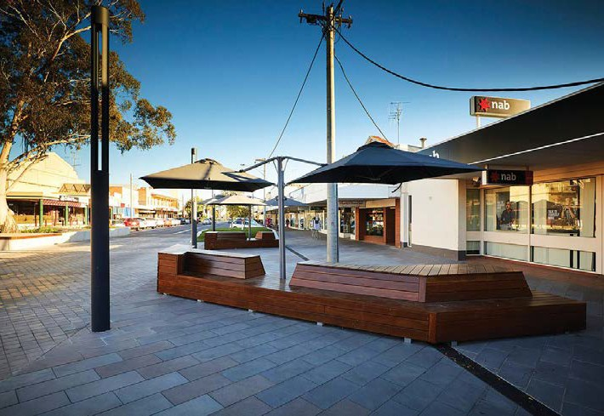
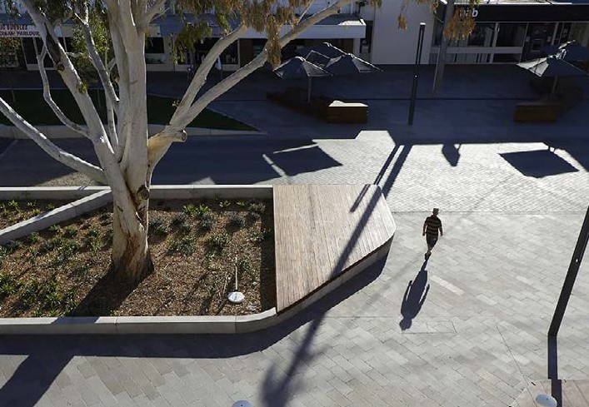
Victoria Square, Kerang (VIC)
By Hansen Partnership
BRINGING THE COMMUNITY TOGETHER

Slide 18
“There is no power for change greater than a
community discovering what it cares about.”
Margaret J. Wheatley

